Slide 1
Helping Tourist’s & Increasing Tourism in Chennai Presentation

Slide 2
Project analysis slide 2
Project Flow
RESULTS & CONCLUSION
UNDERSTANDING THE PROBLEM
PROJECT
ANALYSIS
DATA COLLECTION & CLEANING
METHODOLOGY
DATA VISUALIZATION

Slide 3
Project analysis slide 3
Understanding the Problem
Chennai also known as Madras is the capital of the Indian state of Tamil Nadu. Chennai was among the most-visited Indian cities by foreign tourists. Tourism-guide publisher Lonely Planet named Chennai as one of the top ten cities in the world to visit in 2015. Chennai was ranked the 43rd-most visited city in the world for the year 2015. The Quality of Living Survey rated Chennai as the safest city in India. Chennai attracts 45 percent of health tourists visiting India, and 30 to 40 percent of domestic health tourists. National Geographic mentioned Chennai as the only South Asian city to feature in its 2015 "Top 10 food cities" list. Chennai was also named the ninth-best cosmopolitan city in the world by Lonely Planet. In October 2017, Chennai was added to the UNESCO Creative Cities Network (UCCN) list for its rich musical tradition. In recent days, the tourism of this beautiful city has decreased. Tourism not only adds to the country's economy but is a core part of income. How do we increase tourism and bring back the popularity of the city? In-order to achieve this, we need the tourists to have a good experience and moreover a personalized one. We can achieve this with the help of data science. With all this tourist attraction taken into account, a system that can find a place suitable for the tourist to visit during their stay will be helpful. Our goal is to identify places based on their rating & pricing and make it visible to the tourists in-order for them to choose a place to visit based on their budget and based on the venue's rating. This will eventually increase the tourism level of Chennai.

Slide 4
Project analysis slide 4
Collecting the Data &
Process Flow
Cluster-1
Collection of data of venues within a 5km radius of Chennai.
FourSquareAPI
Data Cleaning & Visualization
Methodology & Analysis
Cluster-2
Collection of rating, pricing, ... With the help of the venues obtained from the FourSquareAPI.
Filtering the data & deriving conclusions through visualization.
Affinity Propagation Clustering.
…
ZomatoAPI
Cluster-N

Slide 5
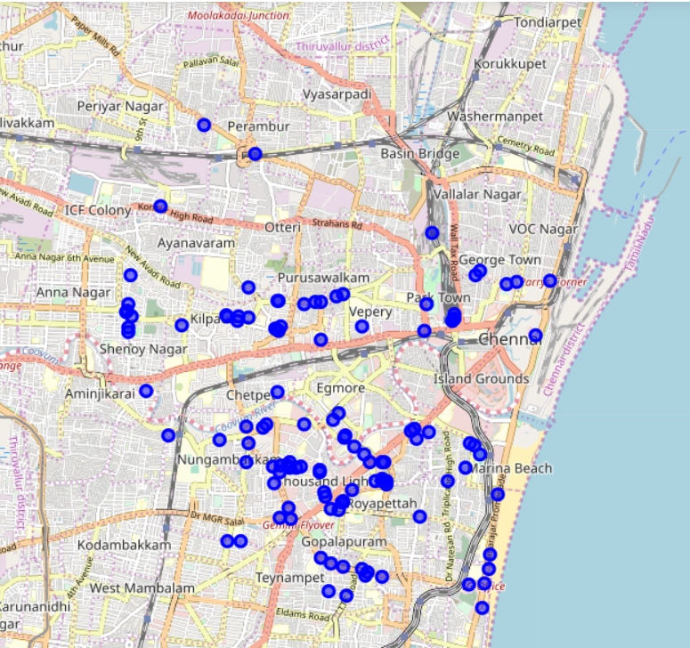
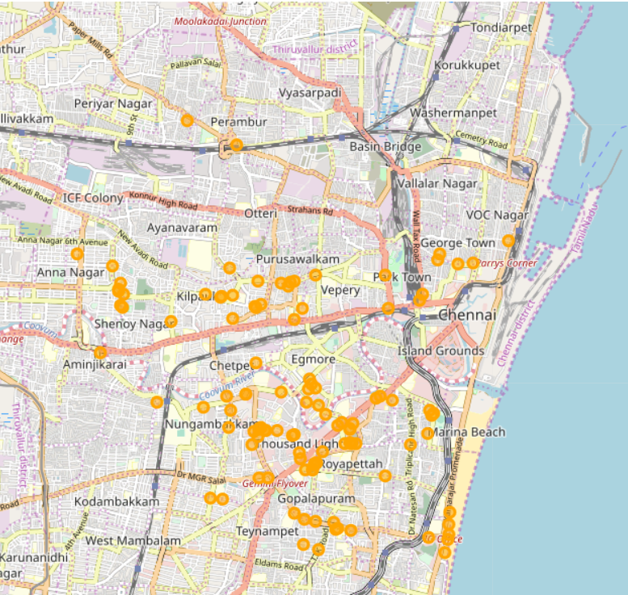
Project analysis slide 5
Data Visualization
FourSquareAPI Venues
ZomatoAPI Venues

Slide 6
Data Cleaning
Data collected from both the FourSquareAPI & the ZomatoAPI are stored in two different data-sets. We have to combine these two data-sets and remove the repeated & unwanted data.
We calculate the latitude & longitude difference for each venue in the two datasets & remove the venues which have a latitude difference & longitude difference of greater than 0.0004.
On combination of these two data-sets, we are left with a single data-set but we have a few repeated columns such as venue name, latitude & longitude. In-order to remove this, we have to drop one of the two repeated columns for each type and finally we are left with a single data-set with no repeated columns.
Some of the data have their rating column value to be 0, which clearly means that the venue is not rated. Hence, we have to remove the venues with a rating of 0, so that we do not advertise wrong information.
Now the data is clean and ready for the next step.

Slide 7
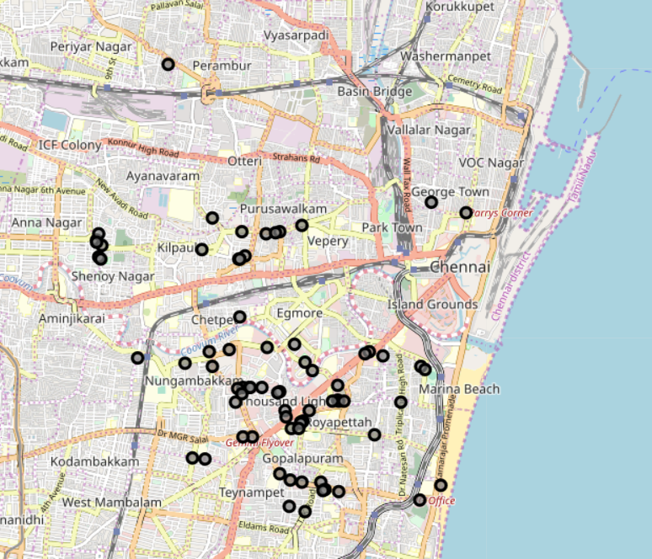
Data Visualization
On Combining both the FourSquareAPI venues & ZomatoAPI venues after cleaning some repeated & overlapping venues, we get the following map.

Slide 8
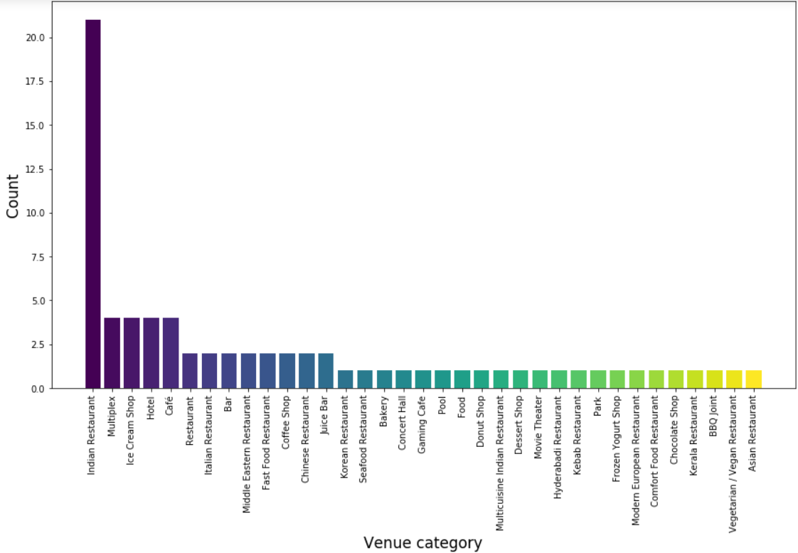
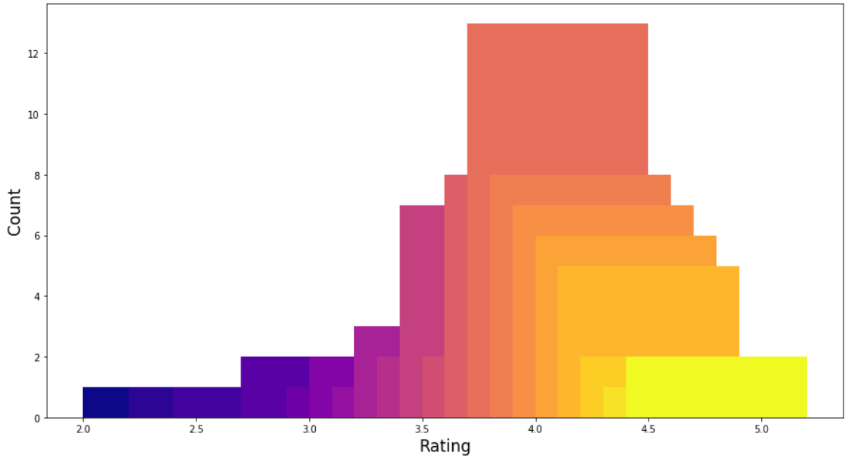
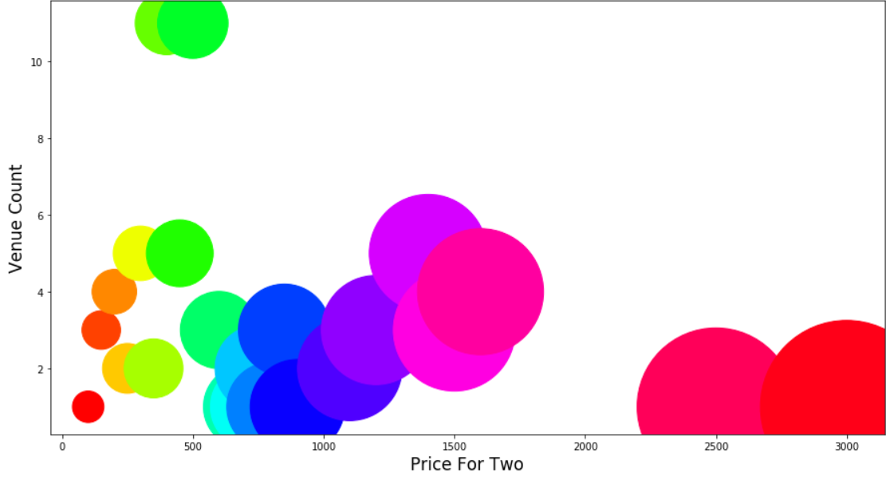
Data Visualization
Graphical Analysis
Venue Category Vs. Count
Conclusion :
Lots of Indian Restaurants
Rating Vs. Count
Conclusion :
Average rating of 3.5-4.5
Price For Two Vs. Count
Conclusion :
Most venue’s priced between 400 & 1500 Rupees.

Slide 9
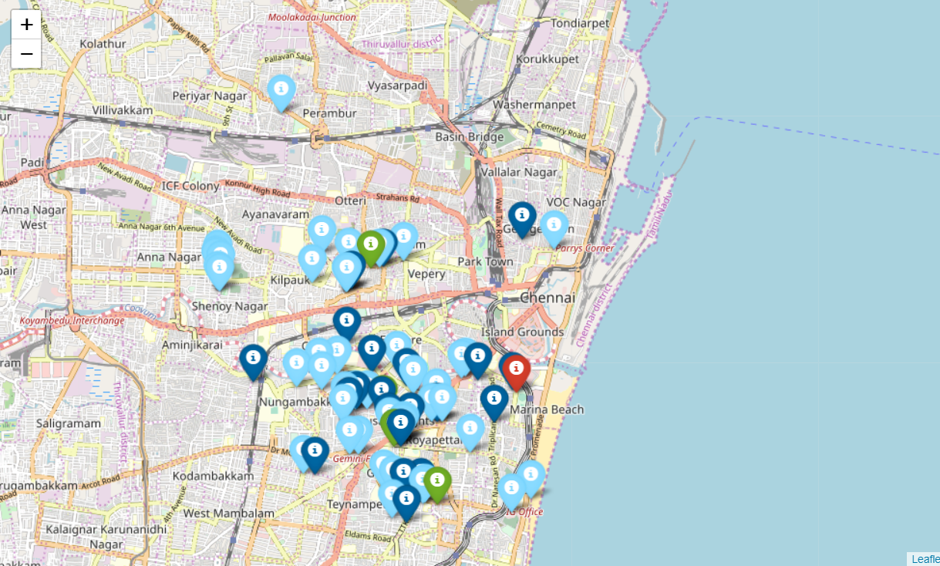
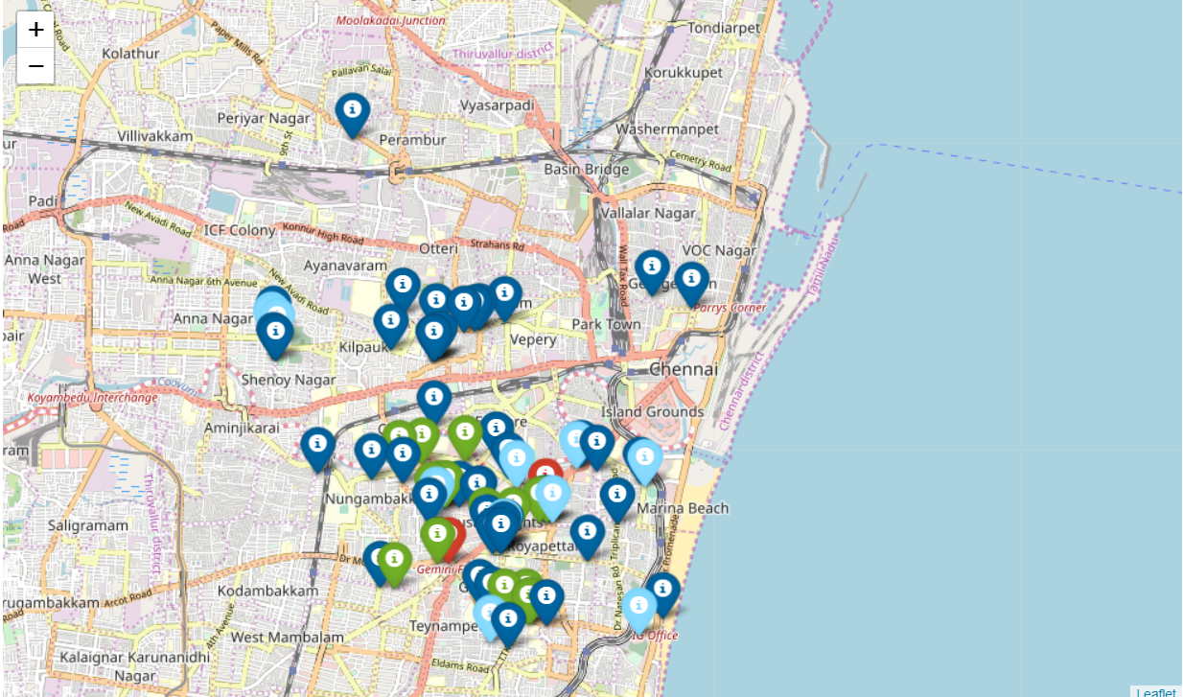
Data Visualization
Map : Venues marked according to their rating.
Color code:
• 0-2.5 (Bad) rating is red
• 2.5-3.2 (Average) rating is green
• 3.2-4.2 (Good) rating is light-blue
• 4.2-5.0 (Excellent) rating is dark-blue
Map : Venues marked according to their pricing.
Color code:
• Cheap is dark-blue
• Average is light-blue
• Affordable is green
• Expensive is red

Slide 10
Project analysis slide 6
Methodology
Since the data we have is unsupervised we will be use a clustering algorithm to cluster the data based on their features. So let us begin the clustering phase.
We will be using a method known as Affinity Propagation Clustering.
Affinity Propagation is a newer clustering algorithm that uses a graph-based approach to let points ‘vote’ on their preferred ‘exemplar’. The end result is a set of clusters from which we derive clusters by essentially doing what K-Means does and assigning each point to the cluster of its nearest exemplar.
Affinity Propagation has some advantages over K-Means. First of all, the graph-based exemplar voting means that the user doesn’t need to specify the number of clusters. Second, due to how the algorithm works under the hood with the graph representation it allows for non-metric dissimilarities.
On clustering, we are left with 6 clusters. We then plot these clusters onto the map with the help of the folium library.

Slide 11
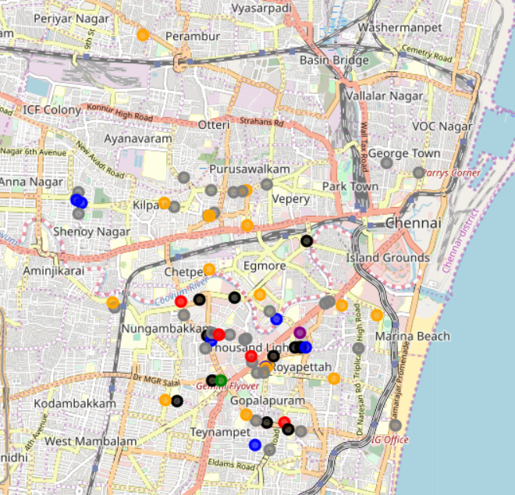
Project analysis slide 7
Analysis
On clustering, we are left with the following results:
Cluster 0:
Color : Purple
Average Price for two : 2500.00
Average Rating : 4.20
No of Venues : 1
Cluster 3:
Color : Blue
Average Price for two : 806.25
Average Rating : 4.09
No of Venues : 8
Cluster 1:
Color : Red
Average Price for two : 1160.00
Average Rating : 4.26
No of Venues : 5
Cluster 4:
Color : Green
Average Price for two : 3000.00
Average Rating : 4.10
No of Venues : 1
Cluster 2:
Color : Black
Average Price for two : 1516.67
Average Rating : 4.28
No of Venues : 12
Cluster 5:
Color : Orange
Average Price for two : 225.00
Average Rating : 4.05
No of Venues : 16
Cluster 6:
Color : Grey
Average Price for two : 454.69
Average Rating : 3.91
No of Venues : 32

Slide 12
Project analysis slide 8
Results & Discussion
Our analysis provides an insight on the venues within a 5km radius of Chennai.
We had found that most venues were located in and around Nungambakkam & Thousand Lights.
The most common venue category was Indian restaurants, tourists can enjoy the Indian cuisine & Chennai's culture.
The city of Chennai mostly consists of venues rated between 3.5 & 4.5, this is evidence that the venues are well taken care of and satisfy their customers.
Most of the venues have their prices between 500 Rupees & 1500 Rupees, this is also evidence that the city of Chennai is an affordable place where you can have a great time at decent prices.
The results for the clusters were displayed in the previous slide, tourists can decide the venues they want to visit based on the data of each cluster.

Slide 13
Conclusion
The whole purpose of this analysis is to provide information to the tourists visiting Chennai to make decisions based on their preferences and also promote tourism in Chennai.
We initially acquired data from FourSquareAPI & ZomatoAPI. We cleaned the data by combining the two datasets & removing venues with similar latitude & longitude co-ordinates. We dropped venues which were not given ratings yet and also dropped repeated columns in the combined dataset.
We the visualized the data in the form of bar plots, scatter plots & maps to come to the conclusions mentioned in the results section.
We then grouped the data into clusters with the help of Affinity Propagation Clustering.
In the end this information will only act as a guide or insight to the tourist. The tourist is the one who will make the final decision on where they want to visit based on the rating, pricing, location etc., this clustered data will assist them in making this decision.

Slide 14
Thank You

